Slide 1
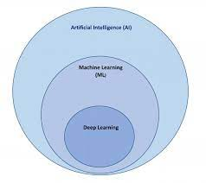
INTRODUCTION TO ML
Machine learning is a subfield of artificial intelligence (AI). The goal of machine learning generally is to understand the structure of data and fit that data into models that can be understood and utilized by people.
Any technology user today has benefitted from machine learning. Facial recognition technology allows social media platforms to help users tag and share photos of friends.

Slide 2
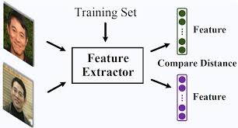
FACE RECOGNITION
Face recognition is rapidly developing and widely applied aspect of biometric technologies. It is widely used in forensics ,criminal identification,face lock screen etc.
The recent advent of affordable,powerful GPUs and creation of huge fac databases for all aspects of face recognition tasks,ranging from detection and preprocessing to feature representation and classification in verification and identification solutions.
Today we will be discussing different methods of face recognition methods.

Slide 3
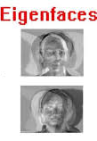
METHODS FOR FACE RECOGNITION
EIGENFACE-the eigenface method is one of the generally used algorithms for face recognition. Eigenfaces are the principal components that divide face into feature vector. The feature vector information can be obtained from covariance matrix. The faces are charecterised by linear combination of highest eigenvalues. Each face can be considered as linear combination of eigenvalues.because of the simplicity of this algorithm ,implementation of eagen face recognition is very easy. The accuracy of eigen face depends on many things. As it takes the pixel value as comparison for projection,the accuracy would decrease with varying light intensity. Preprocessing of image is required to obtain satisfactory result. The major drawback is that it is sensitive to lightening conditions. The size and location of each face image must remain similar to principle subspaces that contain most energy.

Slide 4
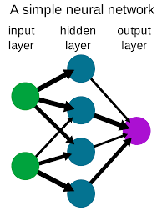
METHODS FOR FACE RECOGNITION
NEURAL NETWORKS-the neural networks are used in many applications like pattern recognition problems ,character recognition,object recognition and autonomous robot driving. The main objective of neural network in face recognition is the feasibility of training a system to capture the complex class of face patterns. The neural network are nonlinear in network so it is widely used technique for face recognition. It features a hierarchical set of layers and provides partial invariance to translational,scale,rotational and deformation. The disadvantage of neural networks is when the number of classes increases.A new approach to face detection with Gabor wavlets and feed forward neural networks is now presented.

Slide 5
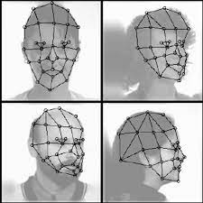
METHODS OR FACE RECOGNITION
ELASTIC BUNCH GRAPH MATCHING-face recognition using elastic bunch graph matching is based on recognising faces by estimating a set of features using a data structure called the bunch graph.Same as for each query image , the landmarks are estimated and located using bunch graph. The feature are extracted by taking the number of instances of gabor filters which is called face graph. The macting percentage is calculated on the basis of similarity between face graph of database and query image . It uses elastic bunch graph to automatically locate points like eyes,nose,mouth,etc and recognise face according to these features. In its simplest version a single labled graph is matched onto an image.The disadvantage of this algorithm is that it is very sensitive to lightening conditions and a lot of graph have to be placed on face.

Slide 6
METHODS OR FACE RECOGNITION
TEMPLATE MATCHING-in template matching we can exploit other face templates from different prospects to characterise single face.The grey levels that match face image can also be processed in proper format.Since the principal components are the linear combination of templates in data basis,the technique cannot achieve better results than correlation.one drawback of template making is its computation complexicity.
IN SUMMARY,NO EXISTING TECHNIQUE IS FREE FROM LIMITATIONS AND FURTHUR EFFORTS ARE REQUIRED TO IMPROVE FACE RECOGNISATION TECHNIQUES.

Slide 7
CONCLUSION
In recent years face reconition has received sustential attention from researchers in biometrics,pattern recognition,and computation vision communities. There are large number of commercial ,securities and forensic applications requiring the use of face recognition techniques. As we know , face recognition system is very important in our daily life ,it possesses a really great advantage. Among the whole types of biometric ,face recognition is most accurate .

Slide 8
THANK YOU

